Slide 1
CS 615: Deep Learning Project
Image Segmentation Using Deep Learning
Created By Himanshu Gupta

Slide 2
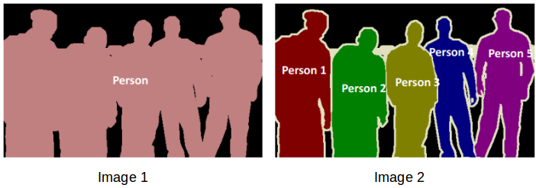
Image Segmentation
Types Of Image Segmentation:
Semantic Segmentation
Also known as pixel level classification where we are grouping pixel which belong to the same object class
Represented by Image 1
Instance Segmentation
Process of detecting each and every unique instance of all the classes present in an image
Represented by Image 2
Detection of objects in images has always been a challenging problem in the field of computer vision and machine learning. Through image segmentation, our goal is to process the images into segments in such a way to represent image into more meaningful way.

Slide 3
Problem Statement
The applications of the image segmentation is limitless. For this project, focus is towards understanding the environment better especially the urban setting where we have a a lot of movement that we don’t notice unless it is affecting us.
It is very important to segmentize our urban environment to effectively use in self-autonomous vehicles, Object tracking in a crowded space, Precise calculations of various parameters such as number of trees, number of small vs big buildings, number of cars parked etc. by just using a video instead of a complex data set.

Slide 4
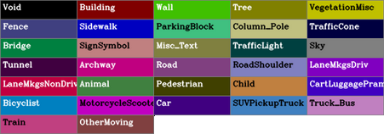
Data Set
We are using a dataset called Cam Seq01 Dataset. It can be found at
http://mi.eng.cam.ac.uk/research/projects/VideoRec/CamSeq01/
It consists of high resolution images of our urban surrounding including images of bicycles, pedestrians, cars, and their motions
This dataset has 101 960X720 pixel images in which each pixel has been assigned to one of the following 32 object classes

Slide 5
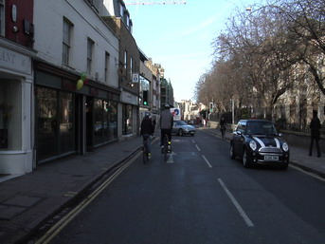
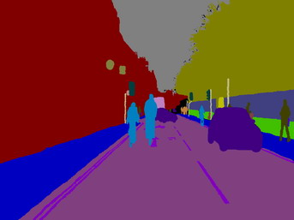
Proposed Solution

Slide 6
Tools Used
Problems To Be Solved:
Python 3
FastAI
TensorFlow
Google Colab
NumPy
MatPlotLib
Keras
Choice of hyper-parameters such as learning rate, number of iterations, and termination criteria.
Choice of Architecture variables such as number of layers, objective and activation functions of the layers, down-scaling and the up-scaling factors.
Processing times are too long given the time-constraint of the project.
Dataset has some void entries, a way to pad around these values in order to not lose valuable feature data.
Randomly breakdown of data into training and testing set is not appropriate for this data as the data is sequence of continuous images from a real-world video. It would be biased to randomly divide our data set.

Slide 7
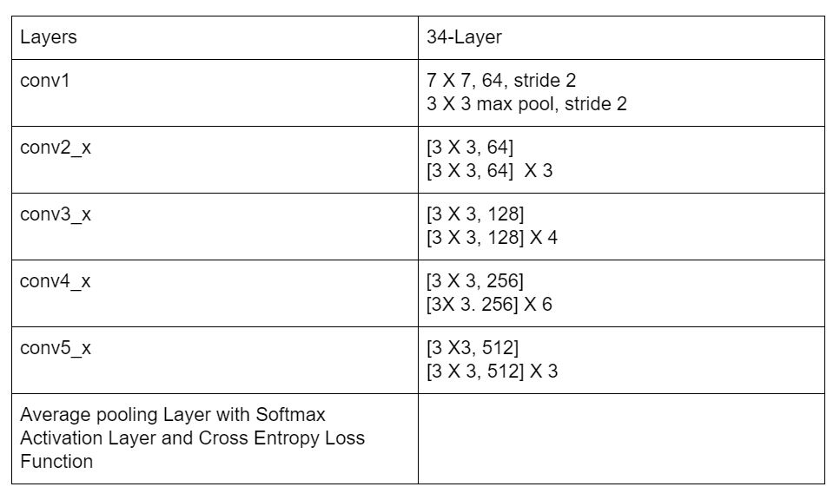
Architecture Used
U-Net
U-Net architecture is the extension of our traditional CNN model based upon the ResNet34, 34 layers dimensions shown in the figure.
CNN downsizes our sample with each layer
U-Net upscales our sample after downsizing forming a U-shaped. Downsizing process is called encoding while upscaling is called decoding
Objective Function: Cross Entropy Loss
Activation Function: Softmax activation function

Slide 8
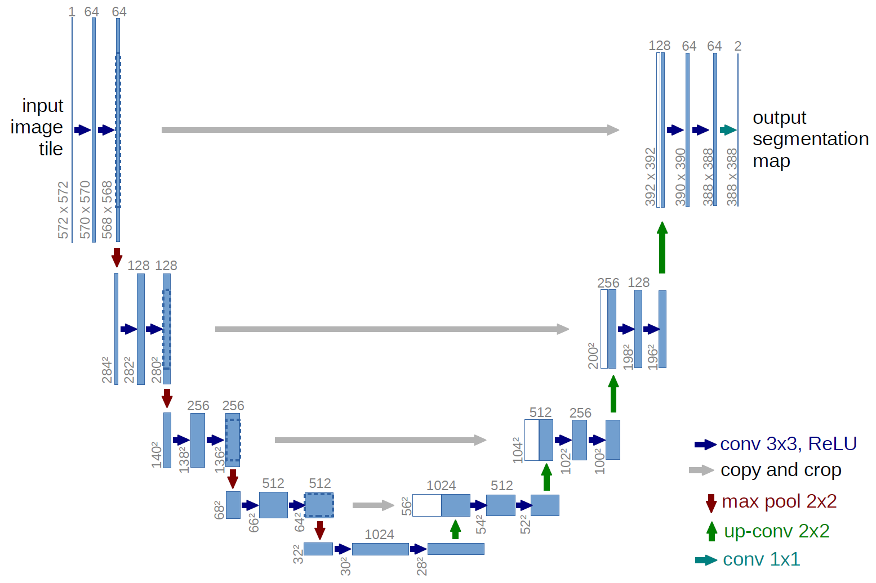
CNN vs U-Net
Transposed convolution is used for upscaling where the width and height of Images are doubled, and depth halved during the encoding process.

Slide 9
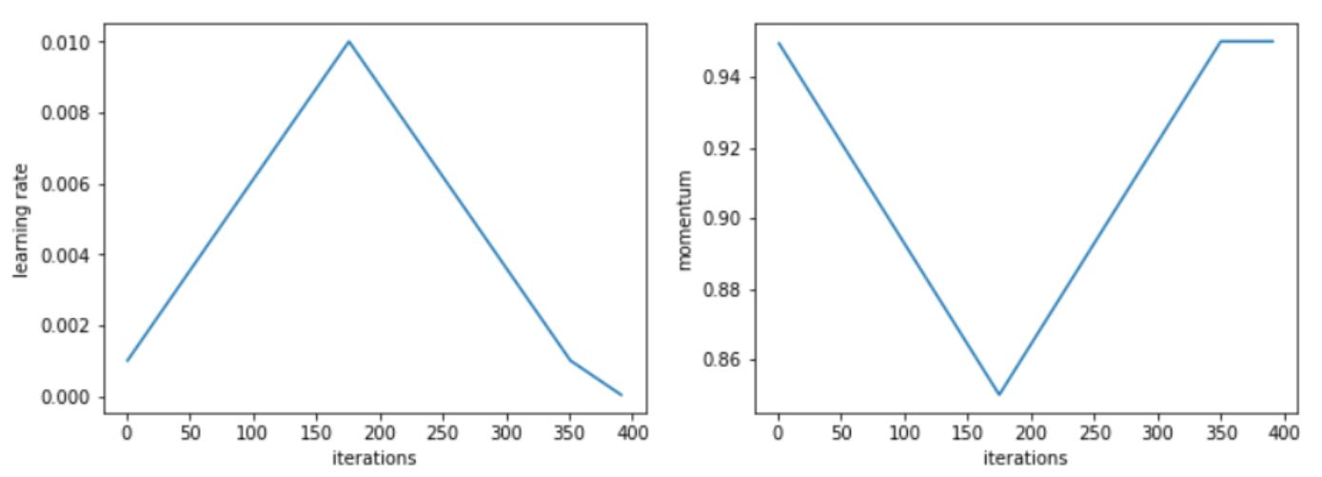
Training Process
One fit Cycle Policy
Variable Learning Rate
Reasoning: Avoid Oscillating values of our weights and objective functions
Increases first to reach global maxima or minima faster, then decreases to settle at a good solution

Slide 10
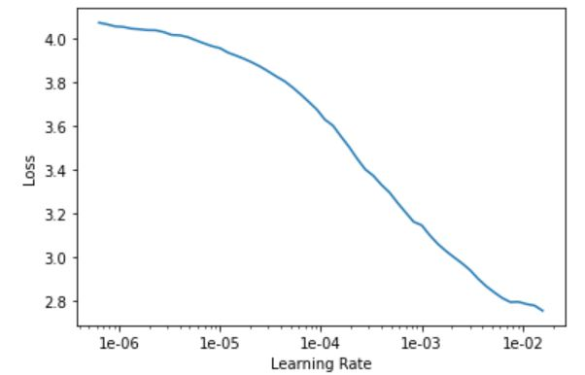
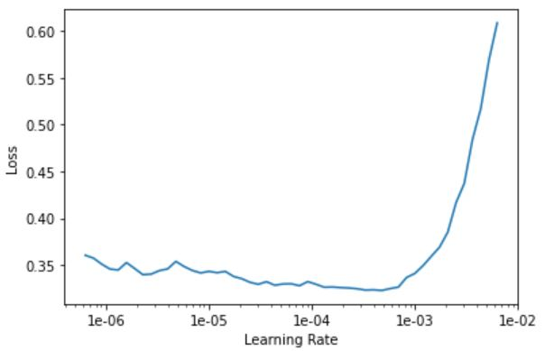
Training Process
Initialization of Learning rate:
Let rip our model for some time, then freeze and plot loss vs learning rate:
Now select Learning rate towards the negative slope and unfreeze model to train using one cycle fit policy using this learning rate.
Loop this process until found a good solution

Slide 11
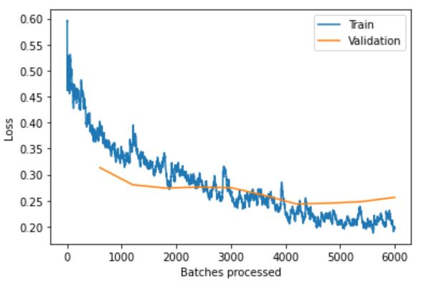
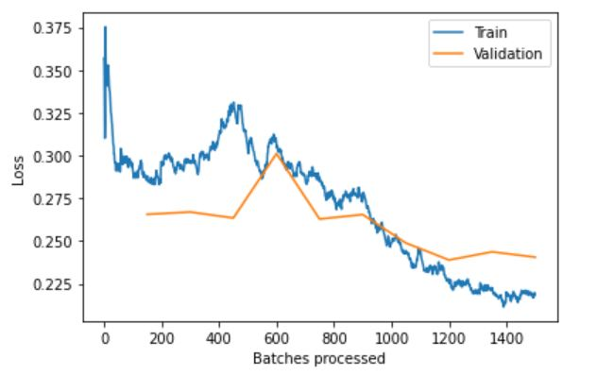
Training Process
After tweaking learning rate further, model is trained in batch with each element of batch starts with the learning rate left over by the previous element in the batch, then purse one fit policy on this learning rate.
Fixed Overfitting by further tweaking the hyper-parameters and increasing the sample size to include full image but GPU limitations so decreased batch size, Got better results.

Slide 12
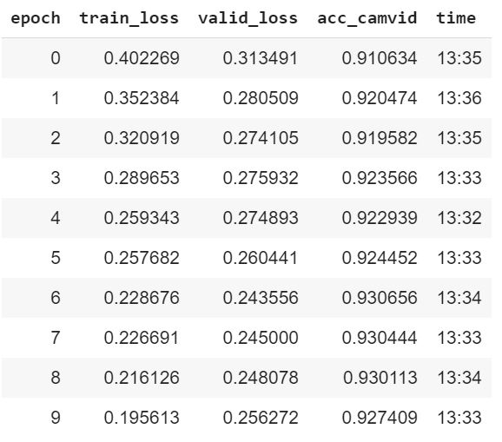
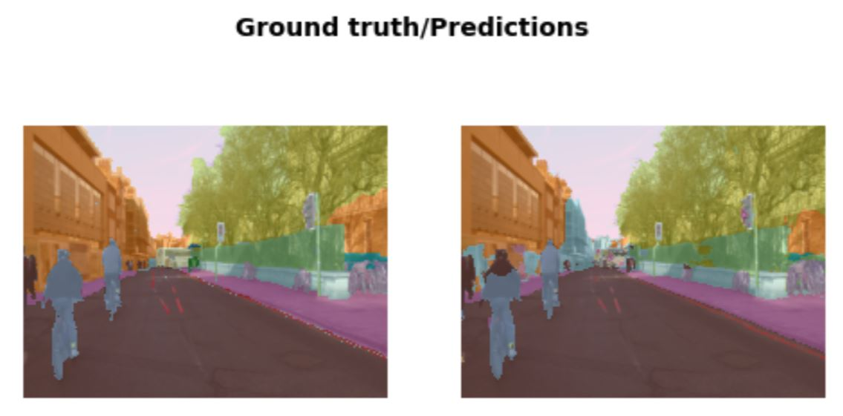
Evaluation
For the evaluation of our model, we evaluate pixel-by-pixel considering every pixel should belongs to some class label. In our case, there are 32 types of object classes.
For the Accuracy calculation, formula is to get the number of correctly predicted pixels over the total number of the pixels.
Accuracy found to around 92%
Ground Truth VS Predictions:

Slide 13
Future Work
In Future, there is a lot of scope of hyper-parameters tuning using techniques like data augmentation, thresholding so Overfitting can be reduced further by tuning these Hyper-parameters
Instead of using only 34 layers, more deep networks could be built as our object classes and feature sizes increases. In order to support this extension, optimization of compiler and CPU FLOPS is needed
These models could be used to generate synthetic urban images to be used by other models for training.
To optimize the performance, images can be shrunken down to sub samples and testing them against our model
On top of the semantic segmentation, edge detection can also be added to produce more meaningful results
Batches could be made out of different urban settings of various testing. This could generate a more generalizable solution.
This project will work on series of images, real time application of this model could be highly successful in various fields like Google Street

Slide 14
Commercial Applications
Image labelling has long been a tedious manual task, so automation is a necessity now a days. It is applicable to each and everything around us
In our project proposal, we have shown its potential in an urban environment
Object tracking is needed in various strict environment where this idea could be used.
With sky's the limit, Following industries are in a process of using this state of art technology to automate various task:
Autonomous Vehicles
Traffic Control Systems
Robotics
Photo/Video Editing Tools

Slide 15
References:
https://www.analyticsvidhya.com/blog/2019/04/introduction-image-segmentation-techniques-python/
https://lmb.informatik.uni-freiburg.de/people/ronneber/u-net/
https://glassboxmedicine.com/2020/01/21/segmentation-u-net-mask-r-cnn-and-medical-applications/
https://towardsdatascience.com/u-net-b229b32b4a71

